Slide 1

#DigitalSkillFair36
Raihan Pratama
Comparison of 6 machine learning algorithms for Breast Cancer Wisconsin dataset

Slide 2
#DigitalSkillFair36
What Is Machine Learning?
MACHINE LEARNING (ML) is a way for computers to 'learn' from experience (data) and make predictions or decisions, without having to be constantly instructed by humans. In other words, the more 'training' a computer receives, the smarter it becomes at recognizing patterns, making decisions, or predicting things.

Slide 3
#DigitalSkillFair36
What Is Breast Cancer Wisconsin dataset?
The Breast Cancer Wisconsin dataset is a classic dataset used for binary classification tasks in machine learning. The objective is to classify breast cancer tumors as either malignant (M) or benign (B) based on features derived from digitized images of breast cancer cell samples.
This dataset is available in Scikit-Learn as a built-in dataset, which means it can be easily loaded using the sklearn.datasets module without needing to download it manually. It is a copy of the UCI ML Breast Cancer Wisconsin (Diagnostic) dataset, originally from the UCI Machine Learning Repository.

Slide 4
#DigitalSkillFair36
Why Is This Dataset Important?
The Breast Cancer Wisconsin dataset is widely used for evaluating classification algorithms in medical diagnosis. Since it is available directly in Scikit-Learn, it is a great choice for testing different machine learning models efficiently.

Slide 5
#DigitalSkillFair36
What Is The Purpose Of This Project?
The Breast Cancer Wisconsin (Diagnostic) dataset is used to evaluate and compare different machine learning algorithms for classifying tumors as benign or malignant. The goal of this project is to identify the most accurate model for early breast cancer detection, helping to improve diagnostic efficiency and patient outcomes.

Slide 6
#DigitalSkillFair36
Get Started

Slide 7







#DigitalSkillFair36
Tools and Libraries

Slide 8
#DigitalSkillFair36
table of contents
Import Libraries and Read Dataset
Explore the Dataset
Exploratory Data Analysis (EDA)
Split Data
Train the Model, Predict & Evaluate and Analysis Results

Slide 9
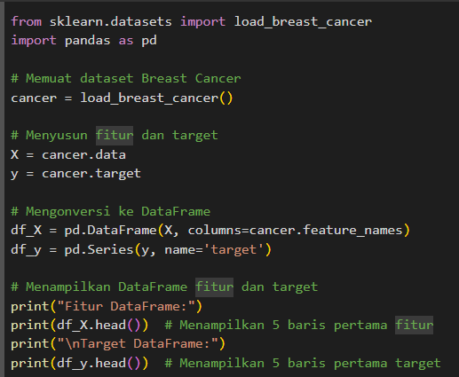
#DigitalSkillFair36
Import Libraries and Read Dataset
In this first step, we start by importing the necessary libraries, namely scikit-learn to load the Breast Cancer Wisconsin (Diagnostic) dataset and pandas to manage the data. This dataset contains tumor features such as radius, texture, perimeter, and area, which are used to classify tumors as benign or malignant. The feature data is put into a DataFrame, while the target (label) is stored in a Series. We display the first few rows of features and targets to understand the data structure before moving on to the analysis and modeling steps.

Slide 10
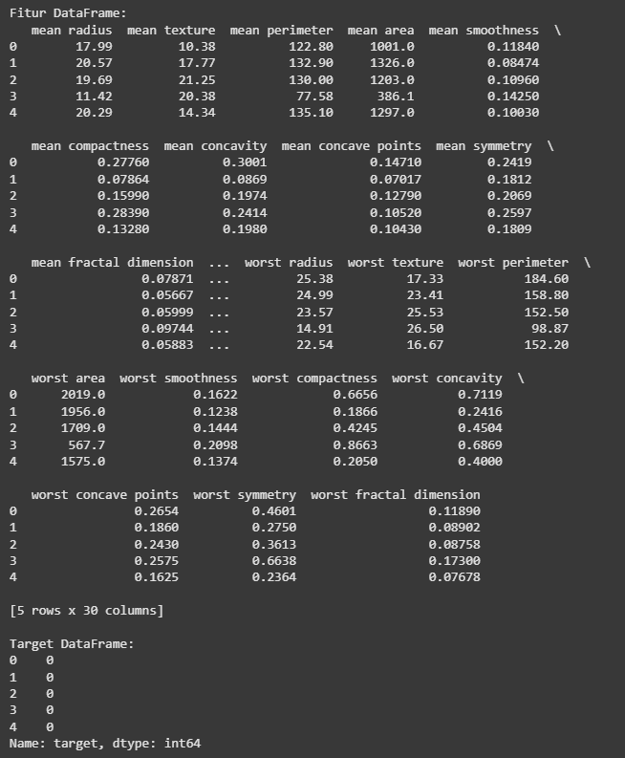
#DigitalSkillFair36
Result

Slide 11
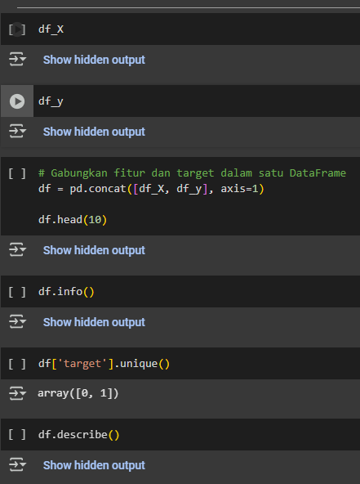
#DigitalSkillFair36
Explore the Dataset
In the Explore Dataset stage, we combine the features and targets into a single DataFrame to facilitate analysis. Then, using df.info(), we check the basic information of the dataset, such as the amount of data and column type. We also check the target class with df['target'].unique(), which indicates two classes: benign (0) and malignant (1). Finally, df.describe() provides descriptive statistics of the features to further understand the data distribution.

Slide 12
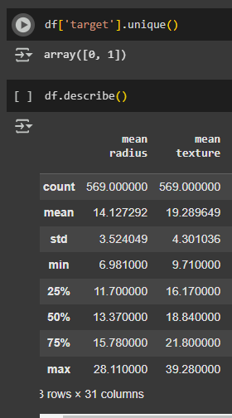
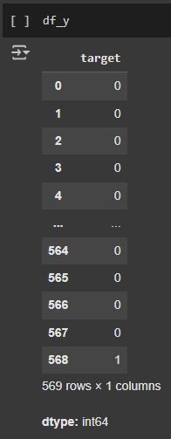
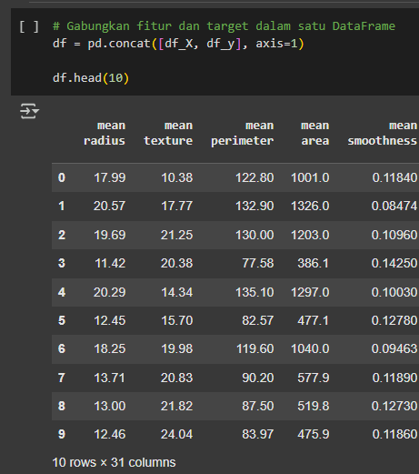
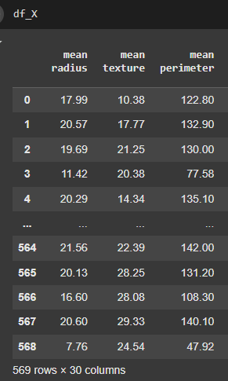
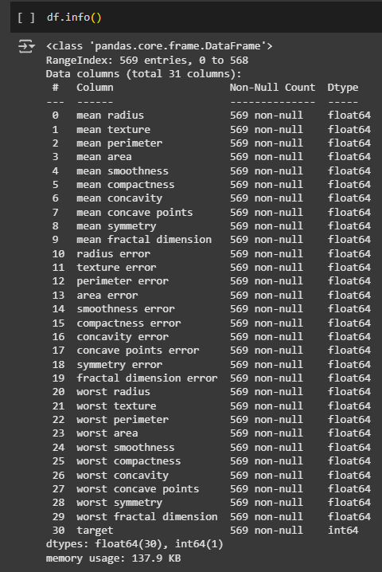
#DigitalSkillFair36
Result

Slide 13
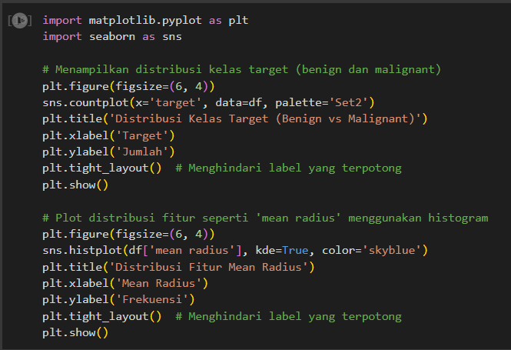
#DigitalSkillFair36
Exploratory Data Analysis (EDA)
In this slide, Exploratory Data Analysis (EDA) is performed to understand the distribution of data in the Breast Cancer Wisconsin (Diagnostic) dataset. First, we visualize the distribution of the target classes (benign and malignant) using a bar plot, which shows the number of benign and malignant cases. Then, we analyze the distribution of key features, such as mean radius, using a histogram to see how the average size of the tumor is spread between the two classes. These two visualizations provide important insights for understanding the data structure and preparing machine learning models.

Slide 14
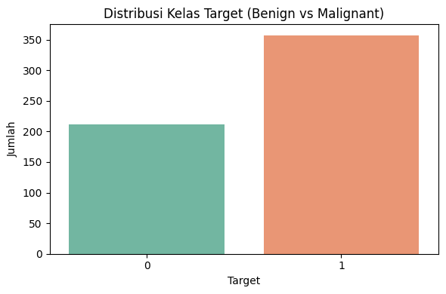
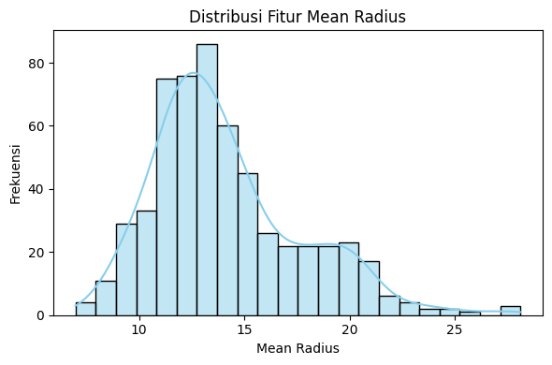
#DigitalSkillFair36
Result

Slide 15

#DigitalSkillFair36
Split Data
This data split part uses train_test_split from scikit-learn to split the dataset into two parts: 80% for training and 20% for testing. The df_X features are used for input, while df_y is the target. random_state=42 ensures a consistent data split each time the code is run, allowing replication of results.

Slide 16
#DigitalSkillFair36
Train the Model, Predict & Evaluate and Analysis Results
Decision Tree
Logistic Regression
Random Forest
Support Vector Machine (SVM)
Naive Bayes
K-Nearest Neighbors (KNN)

Slide 17
#DigitalSkillFair36
Decision Tree

Slide 18
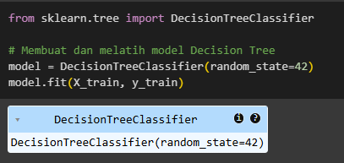
#DigitalSkillFair36
Train the model
In the code on the side, Scikit-Learn's DecisionTreeClassifier is used to build a decision tree model for the classification task. The model is built with the parameter random_state=42 to ensure consistent results each time it is run. Once the model is built, the training data (X_train and y_train) is used to train the model through the fit() method, which allows the model to learn the relationship patterns between features and data labels for classification.

Slide 19
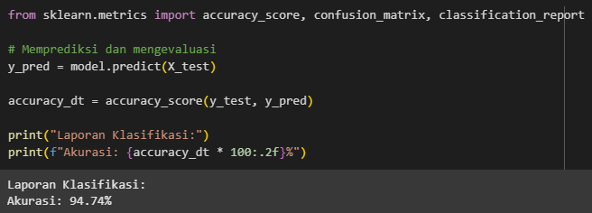
#DigitalSkillFair36
Predict & Evaluate
In the above code, accuracy_score, confusion_matrix, and classification_report are imported from sklearn.metrics to evaluate the performance of the model. The model predicts the test data (X_test) with model.predict(X_test), and the predicted result is compared with the actual label (y_test) using accuracy_score to calculate the model's accuracy. The accuracy result is then displayed as a percentage of two digits behind a comma, such as 94.74%, to show how well the model classifies the test data.

Slide 20
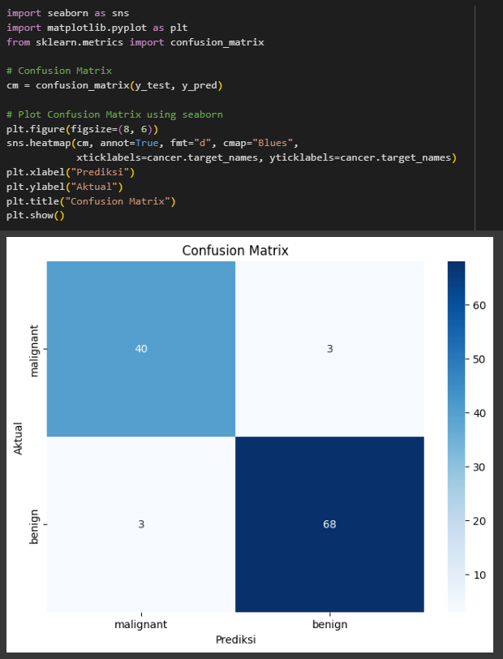
#DigitalSkillFair36
Predict & Evaluate
The code visualizes the confusion matrix using seaborn and matplotlib. It calculates the matrix with confusion_matrix(y_test, y_pred_lr), then displays it as a heatmap. The heatmap shows the number of correct and incorrect predictions for each class (malignant and benign). For the malignant class, there are 40 correct predictions and 3 incorrect predictions, while for the benign class, there are 3 incorrect predictions and 68 correct predictions. The blue color scale makes it easier to interpret the results.

Slide 21
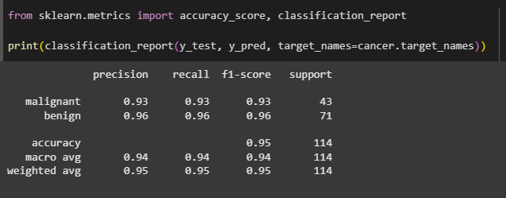
#DigitalSkillFair36
Analysis Results
The classification report shows the performance of the Decision Tree model, with the following metrics:
Precision, Recall, F1-Score: The model performs well for both classes (malignant and benign) with high precision, recall, and F1-scores (around 0.93-0.96).
Accuracy: The model has an overall accuracy of 94.74%, indicating good classification performance.
Macro Average & Weighted Average: Both averages are also high, reflecting balanced performance across all classes.
These results suggest that the Decision Tree model effectively distinguishes between malignant and benign tumors.

Slide 22
#DigitalSkillFair36
Logistic Regression

Slide 23
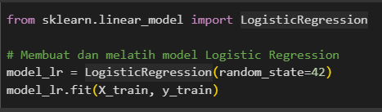
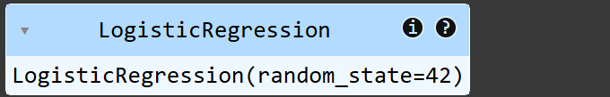
#DigitalSkillFair36
Train the model
In the code on the side, Scikit-Learn's LogisticRegression is used to build a logistic regression model for the classification task. The model is built with the parameter random_state=42 to ensure consistent results each time it is run. Once the model is built, the training data (X_train and y_train) is used to train the model through the fit() method, which allows the model to learn the relationship patterns between features and data labels for classification.

Slide 24
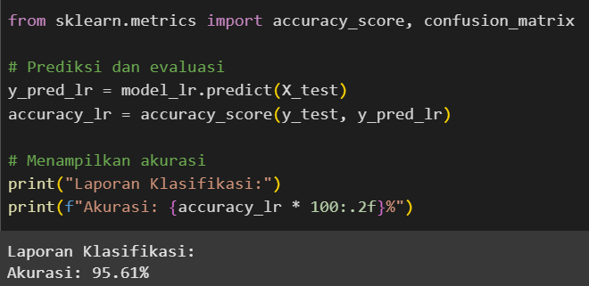
#DigitalSkillFair36
Predict & Evaluate
In the above code, accuracy_score and confusion_matrix are imported from sklearn.metrics to evaluate the performance of the model. First, the model predicts the test data (X_test) using model_lr.predict(X_test), and the predicted results (y_pred_lr) are compared to the actual labels (y_test) using accuracy_score to calculate the model's accuracy. The accuracy value is then displayed as a percentage, formatted to two decimal places (e.g., 95.61%), indicating how well the model performs in classifying the test data.

Slide 25
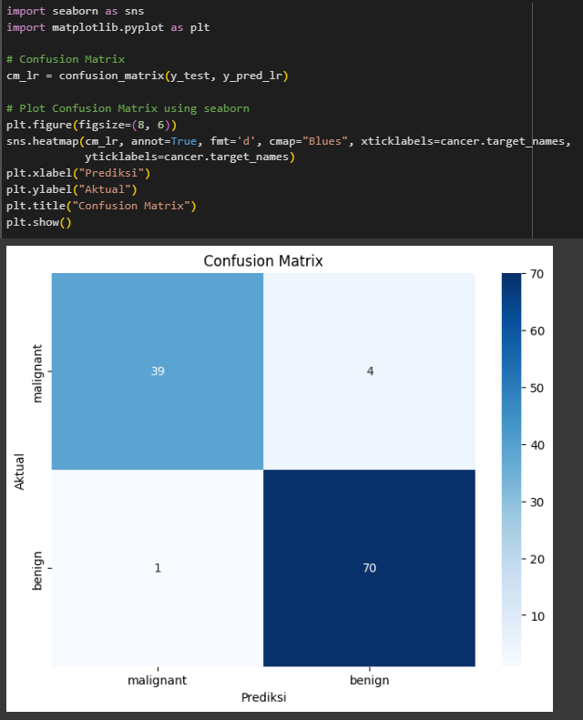
#DigitalSkillFair36
Predict & Evaluate
The code visualizes the confusion matrix using seaborn and matplotlib. It calculates the matrix with confusion_matrix(y_test, y_pred_lr), then displays it as a heatmap. The heatmap shows the number of correct and incorrect predictions for each class (malignant and benign). For the malignant class, there are 39 correct predictions and 4 incorrect predictions, while for the benign class, there are 1 incorrect prediction and 70 correct predictions. The blue color scale makes it easier to interpret the results.

Slide 26
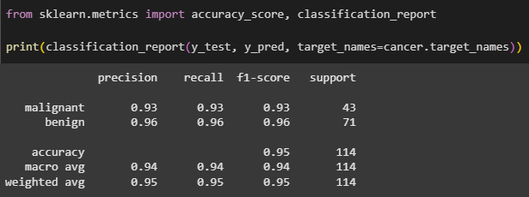
#DigitalSkillFair36
Analysis Results
The classification report shows the performance of the model with the following metrics:
Precision, Recall, F1-Score: The model performs well for both classes (malignant and benign) with high precision, recall, and F1-scores (around 0.93-0.96).
Accuracy: The model has an overall accuracy of 95.61%, indicating strong classification performance.
Macro Average & Weighted Average: Both averages are high, reflecting balanced performance across all classes.
These results suggest that the model effectively distinguishes between malignant and benign tumors.

Slide 27
#DigitalSkillFair36
Random Forest

Slide 28
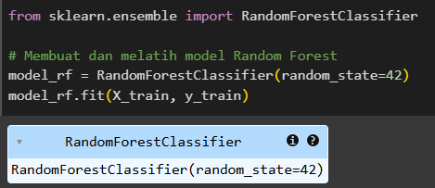
#DigitalSkillFair36
Train the model
In the code on the side, Scikit-Learn's RandomForestClassifier is used to build a random forest classifier model for the classification task. The model is built with the parameter random_state=42 to ensure consistent results each time it is run. Once the model is built, the training data (X_train and y_train) is used to train the model through the fit() method, which allows the model to learn the relationship patterns between features and data labels for classification.

Slide 29
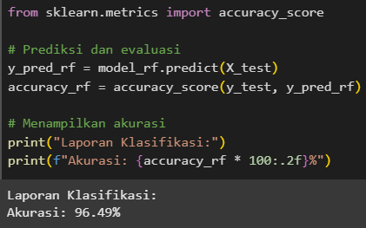
#DigitalSkillFair36
Predict & Evaluate
In the above code, accuracy_score and confusion_matrix are imported from sklearn.metrics to evaluate the performance of the model. First, the model predicts the test data (X_test) using model_rf.predict(X_test), and the predicted results (y_pred_rf) are compared to the actual labels (y_test) using accuracy_score to calculate the model's accuracy. The accuracy value is then displayed as a percentage, formatted to two decimal places (e.g., 96.49%), indicating how well the model performs in classifying the test data.

Slide 30
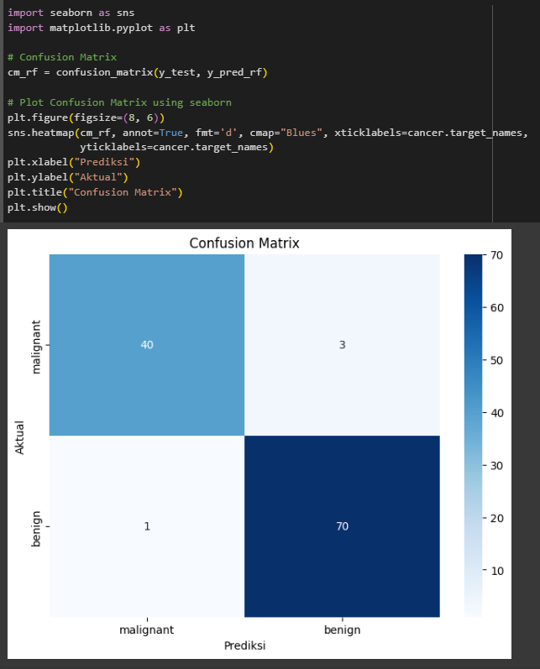
#DigitalSkillFair36
Predict & Evaluate
The code visualizes the confusion matrix using seaborn and matplotlib. It calculates the matrix with confusion_matrix(y_test, y_pred_rf), then displays it as a heatmap. The heatmap shows the number of correct and incorrect predictions for each class (malignant and benign). For the malignant class, there are 40 correct predictions and 3 incorrect predictions, while for the benign class, there are 1 incorrect prediction and 70 correct predictions. The blue color scale makes it easier to interpret the results.

Slide 31
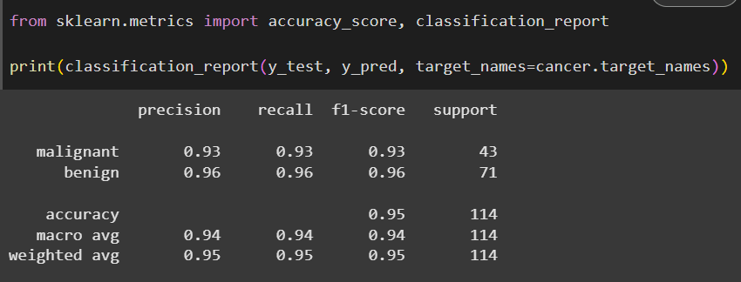
#DigitalSkillFair36
Analysis Results
The classification report shows the performance of the model with the following metrics:
Precision, Recall, F1-Score: The model performs well for both classes (malignant and benign) with high precision, recall, and F1-scores (around 0.93-0.96).
Accuracy: The model has an overall accuracy of 96.49%, indicating strong classification performance.
Macro Average & Weighted Average: Both averages are high, reflecting balanced performance across all classes.
These results suggest that the model effectively distinguishes between malignant and benign tumors.

Slide 32
#DigitalSkillFair36
Support Vector Machine (SVM)

Slide 33
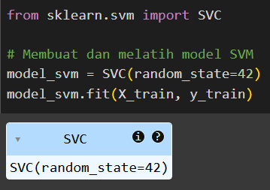
#DigitalSkillFair36
Train the model
In the code on the side, Scikit-Learn's SVC (Support Vector Classifier) is used to build a Support Vector Machine (SVM) model for the classification task. The model is built with the parameter random_state=42 to ensure consistent results each time it is run. Once the model is created, the training data (X_train and y_train) is used to train the model through the fit() method, allowing the model to learn the patterns and relationships between the features and the data labels for classification.

Slide 34
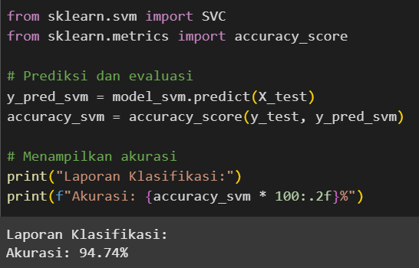
#DigitalSkillFair36
Predict & Evaluate
In the above code, accuracy_score and confusion_matrix are imported from sklearn.metrics to evaluate the performance of the SVM model. First, the model predicts the test data (X_test) using model_svm.predict(X_test), and the predicted results (y_pred_svm) are compared to the actual labels (y_test) using accuracy_score to calculate the model's accuracy. The accuracy value is then displayed as a percentage, formatted to two decimal places (e.g., 94.74%), indicating how well the model performs in classifying the test data.

Slide 35

#DigitalSkillFair36
Predict & Evaluate
The code visualizes the confusion matrix using seaborn and matplotlib. It calculates the matrix with confusion_matrix(y_test, y_pred_svm), then displays it as a heatmap. The heatmap shows the number of correct and incorrect predictions for each class (malignant and benign). For the malignant class, there are 37 correct predictions and 6 incorrect predictions, while for the benign class, there are 0 incorrect predictions and 71 correct predictions. The blue color scale makes it easier to interpret the results.

Slide 36
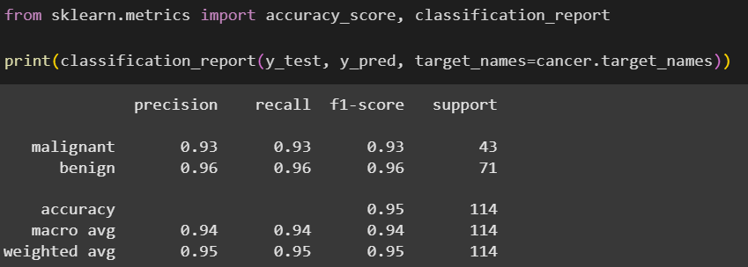
#DigitalSkillFair36
Analysis Results
The classification report shows the performance of the model with the following metrics:
Precision, Recall, F1-Score: The model performs well for both classes (malignant and benign) with high precision, recall, and F1-scores (around 0.93-0.96).
Accuracy: The model has an overall accuracy of 94.74%, indicating strong classification performance.
Macro Average & Weighted Average: Both averages are high, reflecting balanced performance across all classes.
These results suggest that the model effectively distinguishes between malignant and benign tumors.

Slide 37
#DigitalSkillFair36
Naive Bayes

Slide 38
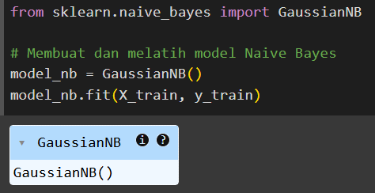
#DigitalSkillFair36
Train the model
In the code on the side, Scikit-Learn's GaussianNB (Naive Bayes classifier) is used to build a Naive Bayes model for the classification task. The model is created without any specific parameters and is trained using the fit() method with the training data (X_train and y_train). This allows the model to learn the relationships between the features and the corresponding labels for classification.

Slide 39
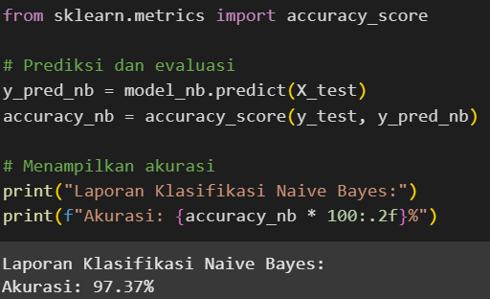
#DigitalSkillFair36
Predict & Evaluate
In the above code, accuracy_score is imported from sklearn.metrics to evaluate the performance of the Naive Bayes model. First, the model predicts the test data (X_test) using model_nb.predict(X_test), and the predicted results (y_pred_nb) are compared to the actual labels (y_test) using accuracy_score to calculate the model's accuracy. The accuracy value is then displayed as a percentage, formatted to two decimal places (e.g., 97.37%), indicating how well the model performs in classifying the test data.

Slide 40
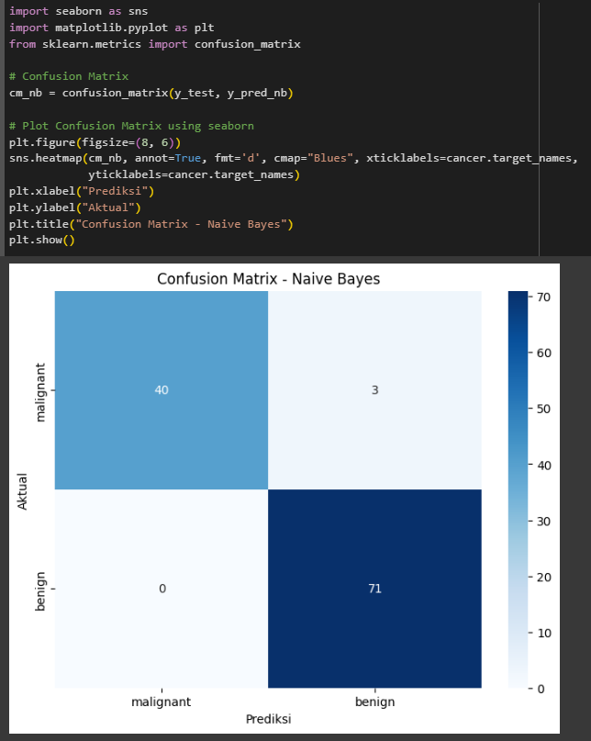
#DigitalSkillFair36
Predict & Evaluate
The code visualizes the confusion matrix using seaborn and matplotlib. It calculates the matrix with confusion_matrix(y_test, y_pred_nb), then displays it as a heatmap. The heatmap shows the number of correct and incorrect predictions for each class (malignant and benign). For the malignant class, there are 40 correct predictions and 3 incorrect predictions, while for the benign class, there are 0 incorrect predictions and 71 correct predictions. The blue color scale makes it easier to interpret the results.

Slide 41
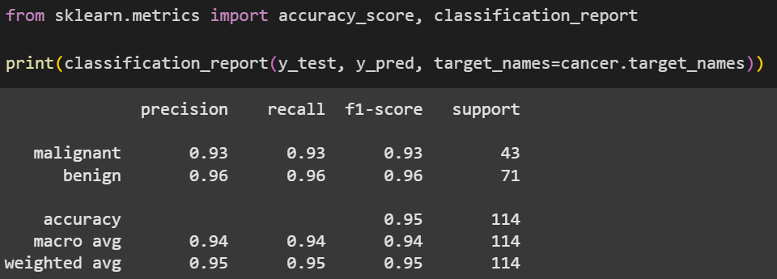
#DigitalSkillFair36
Analysis Results
The classification report shows the performance of the Naive Bayes model with the following metrics:
Precision, Recall, F1-Score: The model performs well for both classes (malignant and benign) with high precision, recall, and F1-scores (around 0.93-0.96).
Accuracy: The model has an overall accuracy of 97.37%, indicating strong classification performance.
Macro Average & Weighted Average: Both averages are high, reflecting balanced performance across all classes.
These results suggest that the Naive Bayes model effectively distinguishes between malignant and benign tumors.

Slide 42
#DigitalSkillFair36
K-Nearest Neighbors (KNN)

Slide 43
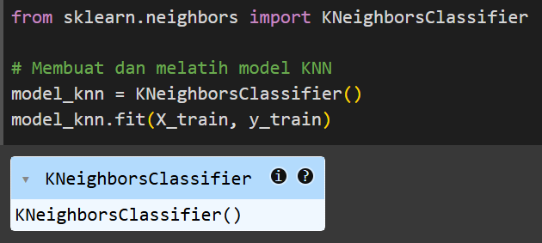
#DigitalSkillFair36
Train the model
In the code on the side, Scikit-Learn's KNeighborsClassifier is used to build a K-Nearest Neighbors (KNN) model for the classification task. The model is created without any specific parameters and is trained using the fit() method with the training data (X_train and y_train). This allows the model to learn the relationships between the features and the corresponding labels for classification based on the K-nearest data points.

Slide 44
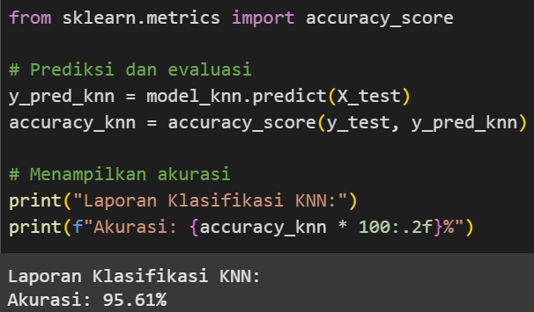
#DigitalSkillFair36
Predict & Evaluate
In the above code, accuracy_score is imported from sklearn.metrics to evaluate the performance of the K-Nearest Neighbors (KNN) model. First, the model predicts the test data (X_test) using model_knn.predict(X_test), and the predicted results (y_pred_knn) are compared to the actual labels (y_test) using accuracy_score to calculate the model's accuracy. The accuracy value is then displayed as a percentage, formatted to two decimal places (e.g., 95.61%), indicating how well the model performs in classifying the test data.

Slide 45
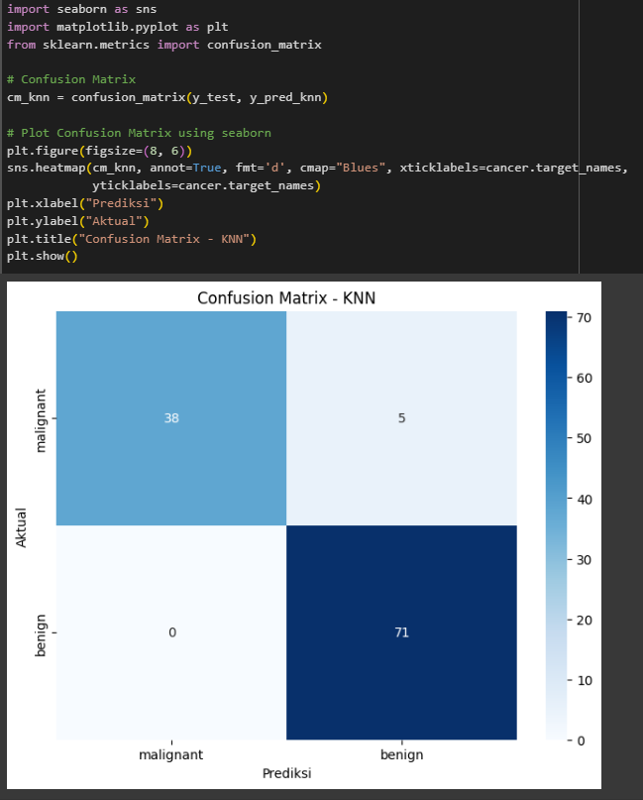
#DigitalSkillFair36
Predict & Evaluate
The code visualizes the confusion matrix using seaborn and matplotlib. It calculates the matrix with confusion_matrix(y_test, y_pred_knn), then displays it as a heatmap. The heatmap shows the number of correct and incorrect predictions for each class (malignant and benign). For the malignant class, there are 38 correct predictions and 5 incorrect predictions, while for the benign class, there are 0 incorrect predictions and 71 correct predictions. The blue color scale makes it easier to interpret the results.

Slide 46
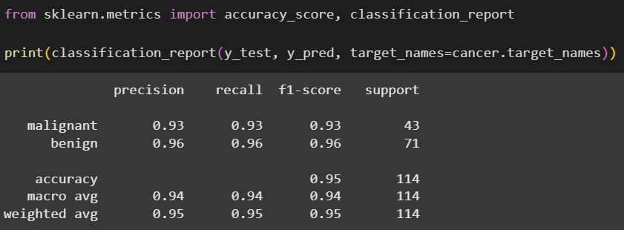
#DigitalSkillFair36
Analysis Results
The classification report shows the performance of the K-Nearest Neighbors (KNN) model with the following metrics:
Precision, Recall, F1-Score: The model performs well for both classes (malignant and benign) with high precision, recall, and F1-scores (around 0.93-0.96).
Accuracy: The model has an overall accuracy of 95.61%, indicating strong classification performance.
Macro Average & Weighted Average: Both averages are high, reflecting balanced performance across all classes.
These results suggest that the KNN model effectively distinguishes between malignant and benign tumors.

Slide 47
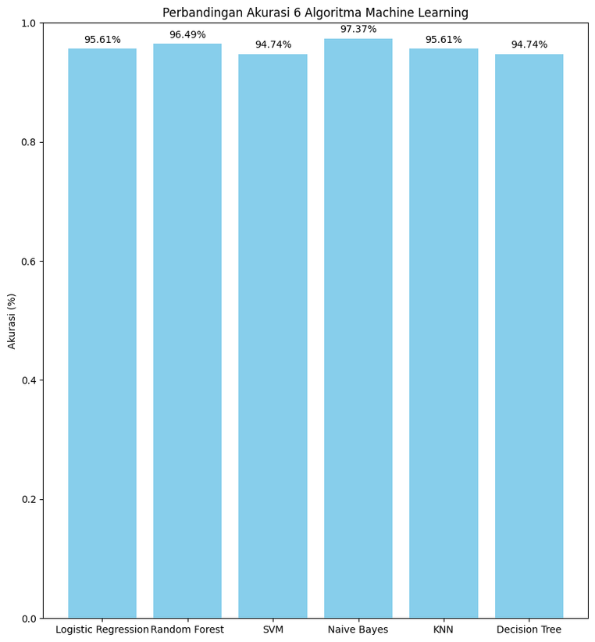
#DigitalSkillFair36
Comparison
The bar chart compares the accuracy of six machine learning algorithms. The accuracy values for each model are as follows:
Logistic Regression: 95.61%
Random Forest: 96.49%
SVM: 94.74%
Naive Bayes: 97.37%
KNN: 95.61%
Decision Tree: 94.74%
The chart clearly shows that the Naive Bayes model achieves the highest accuracy, while other models such as Random Forest and Logistic Regression also show strong performance, all hovering around 95% to 97%.

Slide 48
#DigitalSkillFair36
Conclusion
Based on the analysis and comparison of six machine learning algorithms on the breast cancer dataset, Naive Bayes showed the best performance with 97.37% accuracy, followed by Random Forest and Logistic Regression with 96.49% and 95.61% accuracy. Although KNN and Decision Tree had slightly lower accuracies of 95.61% and 94.74%, they still gave excellent results in classification. All models showed high precision, recall, and F1-score, with Naive Bayes and Random Forest standing out. The confusion matrix showed that the majority of correct predictions occurred for both malignant and benign classes, with minimal error. Overall, Naive Bayes was the best choice for this classification, but Random Forest and Logistic Regression also gave solid performances. The selection of the best model depends on factors such as speed and interpretability required in the application.

Slide 49

#DATASERIES17
THANK YOU

